Slide 1
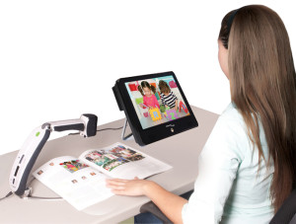
Writing Assistive Technology (AT) in the IEP: A brief guide
Washoe County School District
AT Team
Revised February, 2021

Slide 2

School districts must provide AT to students who require devices and services...
IDEA Section 300.105:
Each public agency shall ensure that assistive technology devices and assistive technology devices and services, or both, as those terms are defined in Sections 300.5 and 300.6, are made available to a child with a disability if required as a part of the child’s —
Special education under Section 300.36;
Related services under Section 300.34; or
Supplementary aids and services under Section 300.38 and 300.114(a)(2)(ii).

Slide 3

IEP Teams must consider AT:
IDEA regulations part C: Sec. 300.346 Development, review, and revision of IEP:
“Consider whether the child requires assistive technology devices and services”
AT must be considered for every student with an IEP

Slide 4
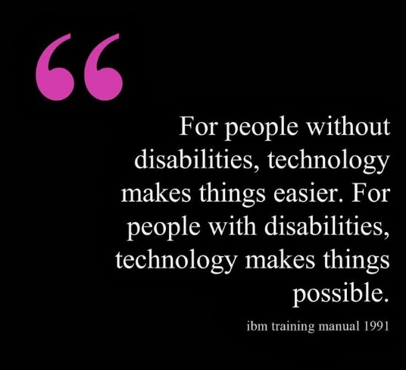
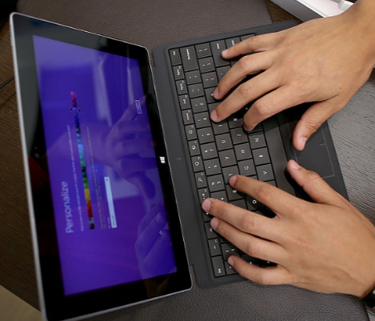
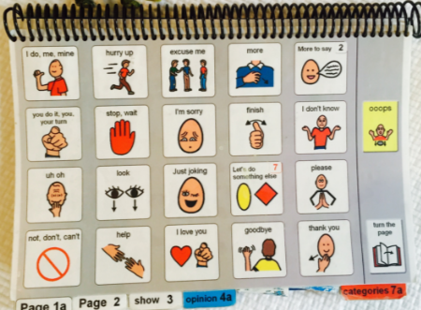
What are Assistive Technology devices and services?
AT devices, whether no-tech or high-tech, assist students in completing tasks they might not otherwise be able to complete and otherwise access their education
AT services are those that help students and teams select and utilize AT supports
AT devices and services are provided when necessary for a child to receive a Free and Appropriate Education (FAPE) and access the Least Restrictive Environment (LRE)
Notes:
1) Assistive technology device (IDEA, 2004): any item, piece of equipment, or product system, whether acquired commercially off the shelf, modified, or customized, that is used to increase, maintain, or improve the functional capabilities of a child with a disability. The term does not include a medical device that is surgically implanted, or the replacement of such device.
2) Including but not limited to evaluation of need, purchasing, customizing, designing, repairing, maintaining, training, technical assistance (IDEA 2004)

Slide 5

Writing AT in the IEP
Present Levels of Performance
Consideration of Special Factors
Goals and Objectives
Supplementary Aides and Services
Related Services

Slide 6
Present Levels of Performance
An IEP for a student requiring AT devices or services must include a statement about AT
Present Levels should describe the NEED for a device or a service in specific terms
Specific devices (no tech to high tech) that address the needs of the student should be described in Present Levels, once particular devices have been deemed appropriate and necessary
Focusing first on the needs of a student rather than starting with a particular tool is best practice in AT decision making
Once a device is deemed necessary, the IEP should be revised to include a description of the device and its use in the Present Levels
Notes:
Example of device/service in PLOPS: describe difficulties with communication, writing, reading, or accessibility for which AT devices/services may be required
Teams should be very cautious about listing specific devices in IEPs before appropriate consideration as this obligates IEP teams/LEA’s to provide such material and may hinder the AT decision making process
Present Levels that reflect the student’s capabilities, barriers to completing tasks, learning environments and needs related to AT are useful to the consideration process
Descriptions need to be adequate to understand the type of devices being used, including their particular necessary features, how the student utilizes them, and any support students require in the use of AT
If materials are needed from the AT team, a referral to the team is necessary prior to writing specific devices in the IEP
AT staff or someone knowledge in the area and commit resources must be included in the consideration process to enable them to appropriately guide AT decision making and justify providing/purchasing devices for assessment and long term use

Slide 7
Present Levels- an example of describing student need
Betsy exhibits a severe expressive communication impairment. She communicates with peers and adults using vocalizations, gestures, and a few single words. The team is currently using picture supports to aid in communication with assistive technology.
Johnny Jim is a 5th grade student demonstrating difficulty in the area of written expression. He requires access to word processing for all written assignments due to dysgraphia. Use of a portable computer for word processing is made available to him through the school site’s 1-to-1 technology program.

Slide 8


Consideration of Special Factors
Special Factors (Question 2) requires consideration of AT:
Basic consideration questions:
Can the student complete tasks and reach goals with the commonly available resources, tools, and accommodations at the school site?
If the student may require AT, does the site team have the knowledge to make appropriate decisions and are the tools available at the school site? (AT needed – can be provided by school)
Does the team need support with AT decision making and/or need access to tools not available the school? (AT needed – referral to AT team or other appropriate service provider such as audiology, vision, OT, PT)

Slide 9

Annual Goals and Objectives
AT may be included in goals and objectives where appropriate
Assistive technology is used to support students in reaching their goals and objectives
Teams should first develop goals for students, then add reference to any AT that may be necessary to achieve the goals
Notes:
AT is technology, no tech to high tech, used by a person with a disability for a functional purpose
AT “assists” students in accomplishing tasks they might not otherwise accomplish

Slide 10
Goal- including a description of AT
By the next annual IEP meeting, given a variety of grade level texts read aloud/listening, Johnny will identify and match four characters to the correct setting/story using visuals and/or voice output communication device with at least 2 details (visuals/words/actions) about the characters to 80% accuracy on 4 out of 5 trials. (4.RL.3)
By the next annual IEP meeting, given a variety of grade level texts read aloud/listening and a word processor, Johnny will write a two-paragraph essay, including introduction, 2 supporting details, and conclusion with an 80% accuracy on 4 out of 5 trials. (4.RL.3)

Slide 11

Supplementary Aides and Services
Assistive technology tools that have been deemed necessary should be described in the modification, accommodations, and supports
IEP teams should utilize descriptions of devices, include specific necessary features, rather than brand names
If teams identify particular devices through the AT consideration process that are appropriate for functional use assessment in the customary environment (I.e.: classroom), they may be listed in Supplementary Aides and services
Notes:
Timeframes for the functional assessment should be listed in the IEP
IEPs should be revised to reflect outcomes

Slide 12
Descriptions of AT Supports
Content Area | Name of Selected Support | Examples for writing IEPs:
Written Expression | Co:Writer- Word prediction | Software supports for writing. Word processing with word prediction for writing assignments
Reading | Bookshare- Digital text | Accessible Educational Material- Electronic Text with Text-to-speech
Communication | iPad with Proloqou2Go app | Dynamic display voice output communication device

Slide 13

Related Services
A variety of staff members support students in the selection and use of AT devices
Not all students who require AT devices require “Assistive Technology” as a related service in their IEP
Many related service providers such as OT, PT, Vision, and audiology also provide AT in addition to AT Specialists from the AT team
Adding “Assistive Technology” as a related service is only necessary when an IEP team requires the support of an AT Specialist to help with decision making, securing additional materials, or receiving specialized training
Notes:
Many AT tools are available at school sites to meet the needs of the students and site staff may have the knowledge required to make AT decisions and provide needed materials
AT is added as a “consult” so that an AT specialist can work with the site team to determine the scope of assistance needed and collaborate with staff and families to make on-going AT decisions. This will include the evaluation.

Slide 14

Types of Service....
There are four choices for service delivery
Support
Direct
Consult
Assessment
Note: All students who have an IEP or 504 qualify for AT
Type of service delivery is a team decision
Notes:
Qualifying for AT is different than OT and PT where they have to meet a certain criteria.

Slide 15
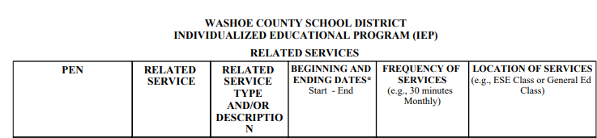

Accelify…
Accelify example:
During writing assignments
During class participation activities
Example: PEN will be specific to student and student may have more than one PEN for AT

Slide 16
Scenario- Will the student require AT as a related service?
Johnny Jim is in the 5th grade and struggles with anything that involves paper/pencil activities and completing assignments. His school has a portable computer for every student. The team has decided to modify Johnny Jim’s assignments so he can use the portable computer for all his work.
Consideration of Special Factors – Check “yes” and make sure to make a statement of the AT in the IEP
Related Service – not required as school can meet the needs of the student

Slide 17
Scenario- Will the student require AT as a related service?
By the next annual IEP meeting, given a variety of grade level texts read aloud/listening, Johnny will identify and match four characters to the correct setting/story using visuals and/or voice output communication device with at least 2 details (visuals/words/actions) about the characters to 80% accuracy on 4 out of 5 trials. (4.RL.3)
Consideration of Special Factors – Check “yes” and make sure the need for AT is reflected in Present Levels
Related Service – add AT and make a referral to the AT team

Slide 18

The WCSD AT Team is here to help (if you need it)!
The Assistive Technology (AT) Team assists IEP teams in making AT decisions and acquiring needed resources, materials, and training that may not be available at school sites
Notes:
Assistance may include:
Guidance in the AT consideration process
Support for IEP teams to assess the functional needs of students related to AT
Selecting, procuring, designing, adapting, maintaining, customizing, or repairing AT tools ranging from no-tech to high-tech
Coordinating with teachers, therapists, other professionals, or agencies regarding assistive technology devices and services
Training and technical assistance for staff, students, and families
Guidance for writing AT into IEPs

Slide 19
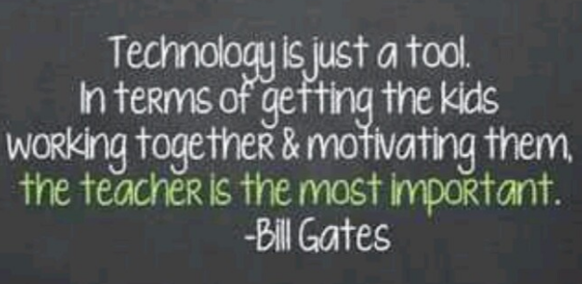
Making Good AT Decisions
Students needs are fluid and ever changing
On-going, collaborative, functional, dynamic AT decisions made in the customary environment best supports student success
School teams are critical to the success of student’s use of AT
After all, AT is not just about technology – AT is about improving the lives of people with disabilities
And we do that together!

Slide 20

Sources:
U.S. Department of Education, Office of Special Education Programs’ (OSEP’s) IDEA website http://idea.ed.gov/explore/view
Engler, Teri. Assistive technology in special education: identifying student needs, responding to parent requests, and other compliance issues. Palm Beach Gardens, FL: LRP Publications, 2013.

